Slide 1
Software Construction
Socket Programming

Slide 2
Sockets Programming
Socket programming is a communication paradigm that enables processes running on different devices or within the same device to communicate over a network.
It involves using sockets, which are endpoints for sending or receiving data across a computer network. Here's a brief overview:

Slide 3
What are sockets
A socket is an end point of a connection for sending or receiving data across a computer network.
Or
Sockets provide a common interface for network communication, regardless of the underlying network protocol (e.g., TCP, UDP) (Transmission control protocol (TCP) and user datagram protocol (UDP))[the interface between user and network]
Two sockets must be connected before they can be used to transfer data (case of TCP)
A number of connections to choose from:
  TCP, UDP, Multicast
Types of Sockets
  SOCK_STREAM, SOCK_DGRAM, SOCK_RAW

Slide 4
Sockets
Message destinations are specified as socket addresses
Each socket address is a communication identifier:
  Internet address
  Port number
The port number is an integer that is needed to distinguish between services running on the same machine
Port numbers between 0 .. 1023 are reserved

Slide 5
Ports
Some “well-known” ports:
  21: ftp
  23: telnet
  80: http
  161: snmp
Check out /etc/services file for complete list of ports and services associated to those ports

Slide 6
Types of Sockets
UDP (User Datagram Protocol) is a communications protocol that is primarily used for establishing low-latency and loss-tolerating connections between applications on the internet. It speeds up transmissions by enabling the transfer of data before an agreement is provided by the receiving party.
Stream Sockets (TCP): Provides a reliable, connection-oriented communication. Used for applications where data integrity is crucial, such as file transfer and web browsing.
Datagram Sockets (UDP): Provides connectionless, unreliable communication. Used for applications where low overhead and speed are more critical, such as online gaming and real-time communication.
UDP -- User Datagram Protocol
TCP -- Transmission Control Protocol
What should I use?
  TCP is a reliable protocol, UDP is not
  TCP is connection-oriented, UDP is connectionless
  TCP incurs overheads, UDP incurs fewer overheads
  UDP has a size limit of 64k, in TCP no limit
TCP (Transmission Control Protocol) is a standard that defines how to establish and maintain a network conversation through which application programs can exchange data. TCP works with the Internet Protocol (IP), which defines how computers send packets of data to each other.

Slide 7
TCP vs UDP
Stream Socket (TCP)
Datagram Socket (UDP)
Connection oriented
Reliable (ordering)
Error control is mandatory
Slow transmission
More overloaded
Flow control, congestion control
HTTP,FTP
File transfer and web browsing
Connectionless
Less reliable (No ordering)
Error control is optional
Fast transmission
Less overload
No Flow control, congestion control
DNS, Boot P, RIP, DHCP
Online gaming and real-time communication

Slide 8
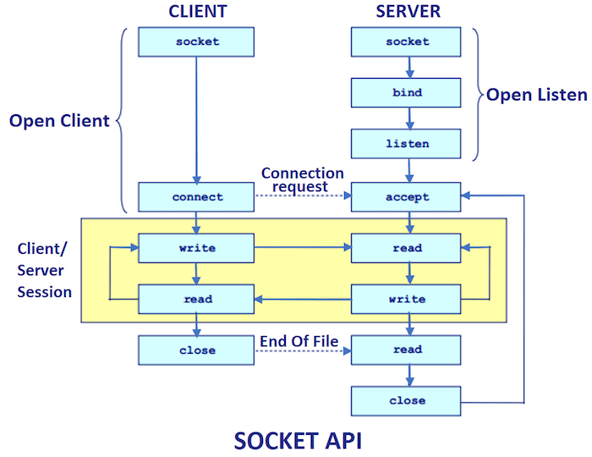

Slide 9
Socket Programming Steps:
Server Side
Create a socket using the socket() function.
Bind the socket to a specific address and port using bind().
Listen for incoming connections using listen().
Accept a connection using accept().
Communicate with the client through the accepted socket.
Client Side
Create a socket using the socket() function.
Connect to the server using connect().
Communicate with the server through the connected socket.

Slide 10
Client/Server Computing
Socket programming often follows a client-server model.
Some hosts (clients, typically desktop computers) are specialized to interact with users:
  Gather input from users
  Present information to users
Other hosts (servers) are specialized to manage large data, process that data
The Web is a good example: Client (Browser) & Server (HTTP server)
  Client: Initiates a connection to the server to request services.
  Server: Listens for incoming connections and provides services.

Slide 11
Client/Server Computing
Other examples:
  E-mail
Server
Client
Client

Slide 12
Client/Server Computing
Other examples:
  Chatroom

Slide 13
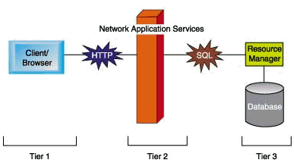
Tiered Client/Server Architecture
1-tier: single program
2-tier: client/server (e.g. the Web)
3-tier: application logic and databases on different servers (e.g. the Web with CGI and databases)

Slide 14
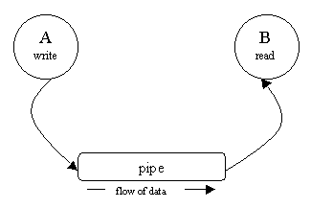
Client/Server Communication
Two related processes on a single machine may communicate through a pipe
A pipe is a pseudo-file that can be used to connect two processes together

Slide 15
Client/Server Communication
Two UNRELATED processes may communicate through files (process A write to a file and process B reads from it)
But HOW two processes located on two different machines communicate? Solution: Berkeley sockets.

Slide 16
TCP Server (server.py)
import socket
# Create a socket
server_socket = socket.socket(socket.AF_INET, socket.SOCK_STREAM)
# Bind the socket to a specific address and port
server_socket.bind(('localhost', 12345))
# Listen for incoming connections
server_socket.listen()
print("Server listening on port 12345...")
# Accept a connection
client_socket, client_address = server_socket.accept()
print(f"Accepted connection from {client_address}")
# Communicate with the client
while True:
data = client_socket.recv(1024)
if not data:
break # Connection closed by the client
print(f"Received from client: {data.decode()}")
client_socket.sendall(data) # Echo back the message
# Close the sockets
client_socket.close()
server_socket.close()

Slide 18
Client (client.py)
import socket
# Create a socket
client_socket = socket.socket(socket.AF_INET, socket.SOCK_STREAM)
# Connect to the server
client_socket.connect(('localhost', 12345))
# Communicate with the server
while True:
message = input("Enter a message to send to the server (type 'exit' to quit): ")
if message.lower() == 'exit':
break
client_socket.sendall(message.encode())
data = client_socket.recv(1024)
print(f"Received from server: {data.decode()}")
# Close the socket
client_socket.close()

Slide 19
OUTPUT
Server Terminal
Client Terminal
Server listening on port 12345...
Accepted connection from ('127.0.0.1', 12345)
Received from client: Hello, server!
Enter a message to send to the server (type 'exit' to quit): Hello, server!
Received from server: Hello, server!
Enter a message to send to the server (type 'exit' to quit): How are you?
Received from server: How are you?
Enter a message to send to the server (type 'exit' to quit): exit

Slide 20
Usage:
Run the server.py script in one terminal.
Run the client.py script in another terminal.
Enter messages in the client terminal, and the server will echo them back.

Slide 21
Socket Programming usage
In real world

Slide 22
Examples (1)
Web Browsing (HTTP):
When you open a web browser and enter a URL, your browser establishes a socket connection with the web server. This connection is used to send HTTP requests and receive the corresponding web pages. The communication is typically done over TCP/IP sockets.
Email Communication (SMTP, IMAP, POP3):
Email clients (like Outlook or Thunderbird) use sockets to communicate with email servers. Simple Mail Transfer Protocol (SMTP) is used for sending emails, while Internet Message Access Protocol (IMAP) and Post Office Protocol (POP3) are used for retrieving emails.

Slide 23
Examples (2)
File Transfer (FTP):
File Transfer Protocol (FTP) uses sockets for transferring files between a client and a server. The client and server establish a connection over which files can be uploaded or downloaded.
Instant Messaging (XMPP, IRC):
Chat applications use socket programming to enable real-time communication between users. Protocols like Extensible Messaging and Presence Protocol (XMPP) and Internet Relay Chat (IRC) rely on sockets for instant messaging.

Slide 24
Examples (3)
Online Gaming (UDP):
Multiplayer online games utilize sockets, especially User Datagram Protocol (UDP), for real-time communication between players. This ensures low-latency interactions, crucial for gaming experiences.
VoIP (Voice over Internet Protocol):
VoIP applications (like Skype or Zoom) use sockets to transmit voice data between users. This enables real-time audio communication over the internet.

Slide 25
Examples (4)
Networked Applications (APIs):
Many applications and services use APIs (Application Programming Interfaces) to communicate with each other over a network. APIs often rely on sockets to establish connections and exchange data.
Database Communication (MySQL, PostgreSQL):
Database servers communicate with client applications (e.g., a web server) using sockets. For example, MySQL and PostgreSQL use sockets for client-server communication.

Slide 26
Examples (5)
Network Monitoring (SNMP):
Simple Network Management Protocol (SNMP) employs sockets for monitoring and managing network devices. It allows administrators to retrieve information from networked devices.
Peer-to-Peer Communication (BitTorrent):
Peer-to-peer file sharing applications, such as BitTorrent, use sockets for communication between peers. This allows users to download and share files directly with each other.
These examples demonstrate the versatility and importance of socket programming in enabling communication between different devices and applications over networks.

